Slide 1
POVS AND PROTOTYPES
Productivity

Slide 2



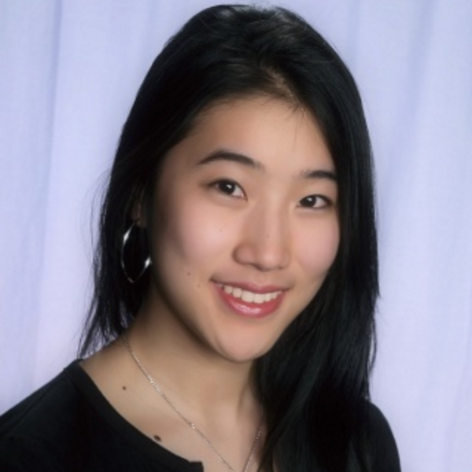
MEET THE TEAM
Ivan Salinas
Sidra Ijaz
Crystal Zheng
Jonathan Mao

Slide 3
Problem Domain:
Human 2.0: Productivity
Notes:
Productivtiy because most people can relate to it

Slide 4
1.
INITIAL POINT OF VIEWS

Slide 5

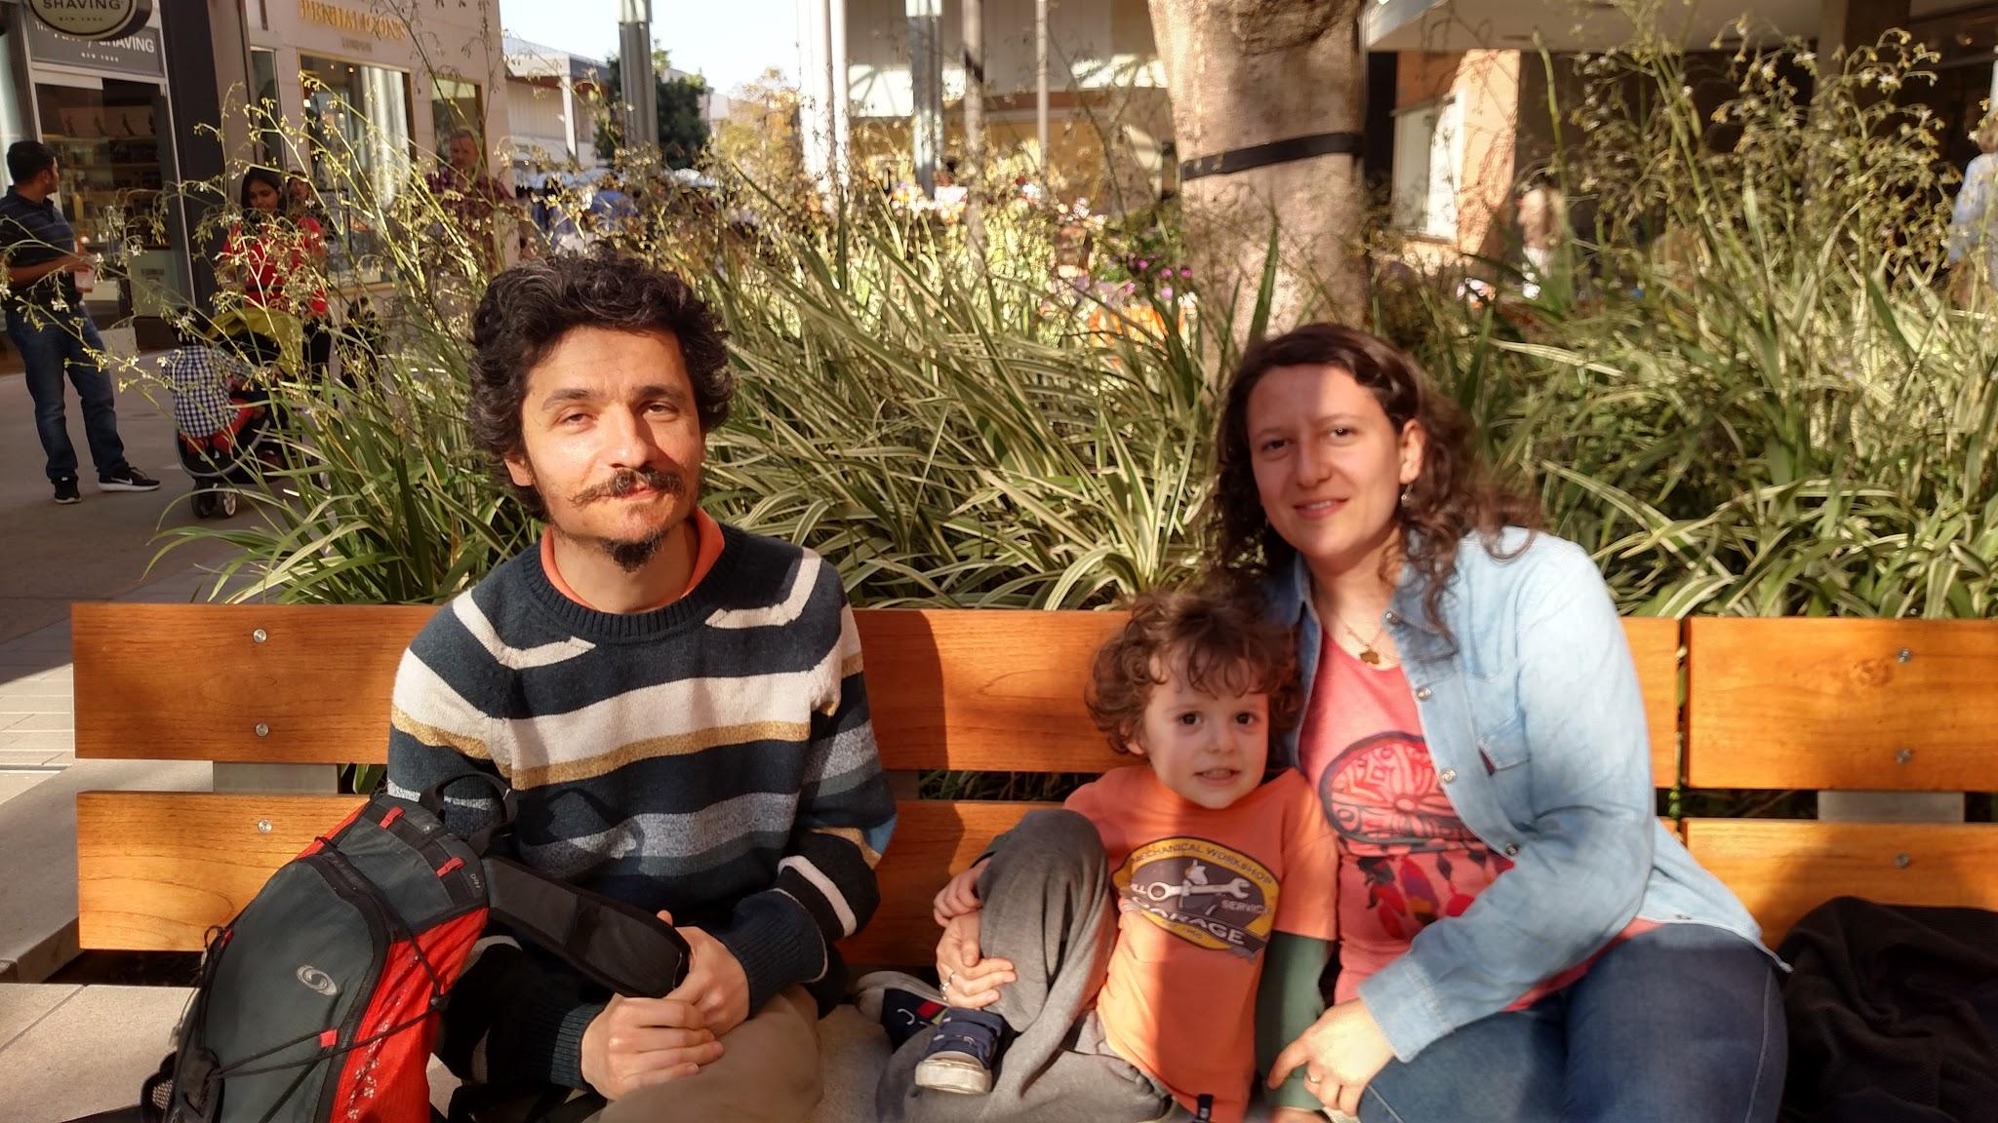
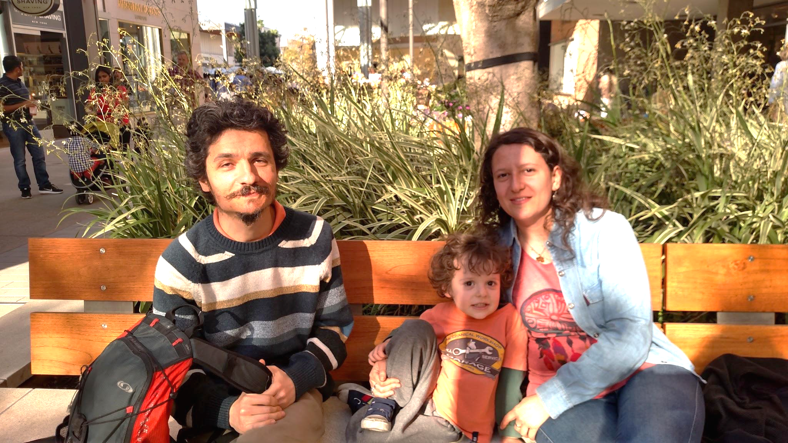
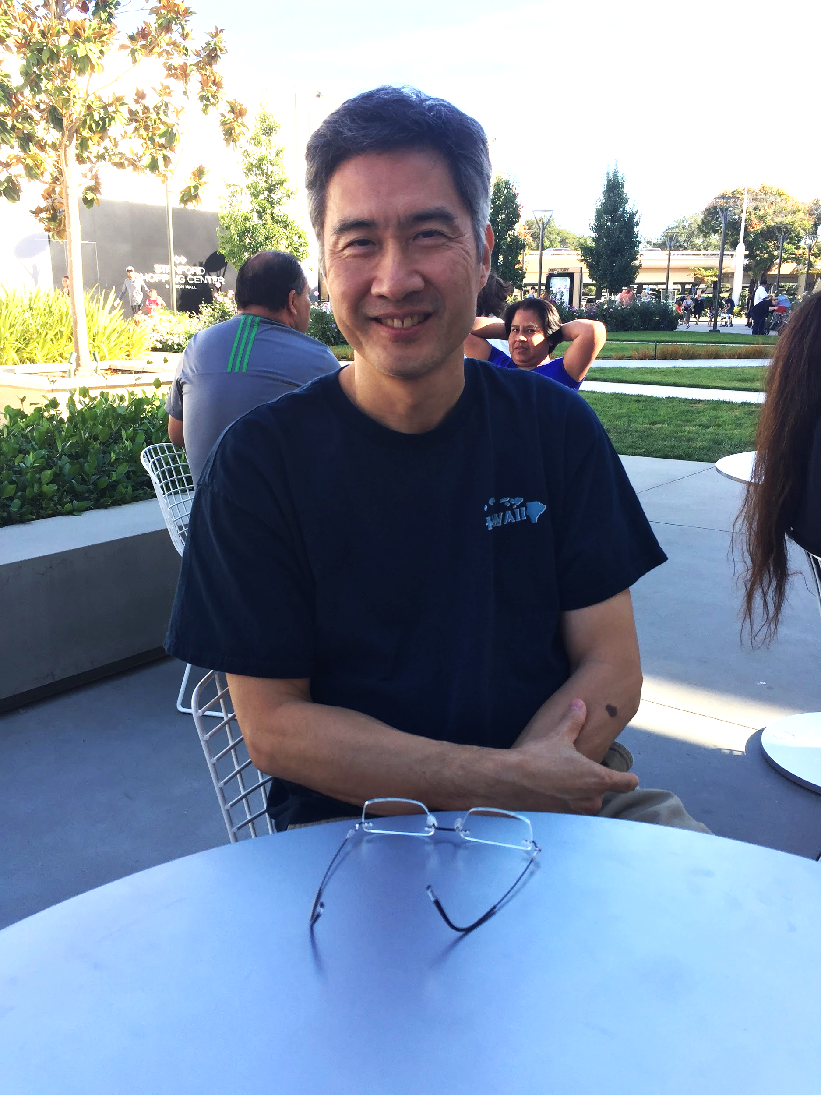
Alana - Academic Skills Coach
Martin- Facebook Engineer/Former Business Owner
Initial Point of Views
Hajime - Software Engineer
Deborah - Mother/Writer
Notes:
We gathered lots of infortmations
-some people like feel of traditional productivity methods
-the struggle of making the best use of a commute

Slide 6
2.
ADDITIONAL NEEDFINDING
Notes:
We realized we needed more information so we did some additional needfinding

Slide 7

Joanne Nguyen
Stanford student studying Communication, works at BEAM
While working on homework she would be distracted by YouTube, social media, and phone notifications.
Health is important for her in maintaining productivity.
She uses a physical planner and Google Calendar to keep track of tasks.
Observed/interviewed her in Crothers computer cluster

Slide 8

Wayne West
Marketing Manager at an Educational Technology Startup
Wayne is very focused, and uses a to-do list + a timer to stay on track.
Social media is no longer a distraction for him
He frequently loses himself on Facebook as a coping mechanism for stress
Met for coffee at a Starbucks in San Jose

Slide 9
3.
REVISED POINT OF VIEWS
+
HOW MIGHT WE...

Slide 10
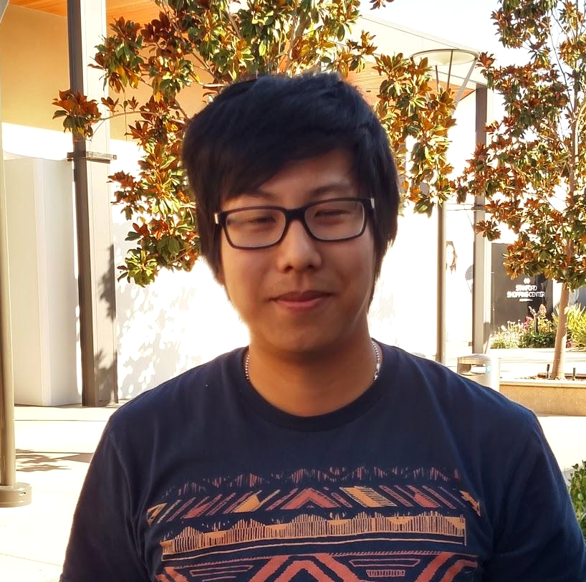
We met...
Justin, an Electrical Engineer in his mid to late 20’s.

Slide 11
We were amazed to realize...
that he sets multiple, consecutive reminders because he ignores the first one and forgets to do his task without another reminder.
It would be game changing to...
help people with bad short-term memory to stay focused on tasks.

Slide 12
We met...
Deborah, a stay-at-home mom and writer.

Slide 13
We were amazed to realize...
that she tries to stay off social media to stay productive, but it’s difficult for her.
It would be game changing to...
find a way to maximize her focus when she works

Slide 14
How Might We:
help people to set up a distraction-free environment?
Notes:
From Deborah we also came up with two of our strongest HMW

Slide 15
How Might We:
encourage people to practice self-control?

Slide 16
We met...
Martin, a Facebook Engineer and former business owner.

Slide 17
We were amazed to realize...
that he had trouble remembering to make time for things outside of work
It would be game changing to...
to increase productivity by helping people improve their health.

Slide 18
How Might We:
encourage people to practice self-care to further their productivity?
Notes:
We formulated our final strongest HMW

Slide 19
4.
PROTOTYPES
Notes:
To put those HMW thoughts to good use, we created prototypes

Slide 20
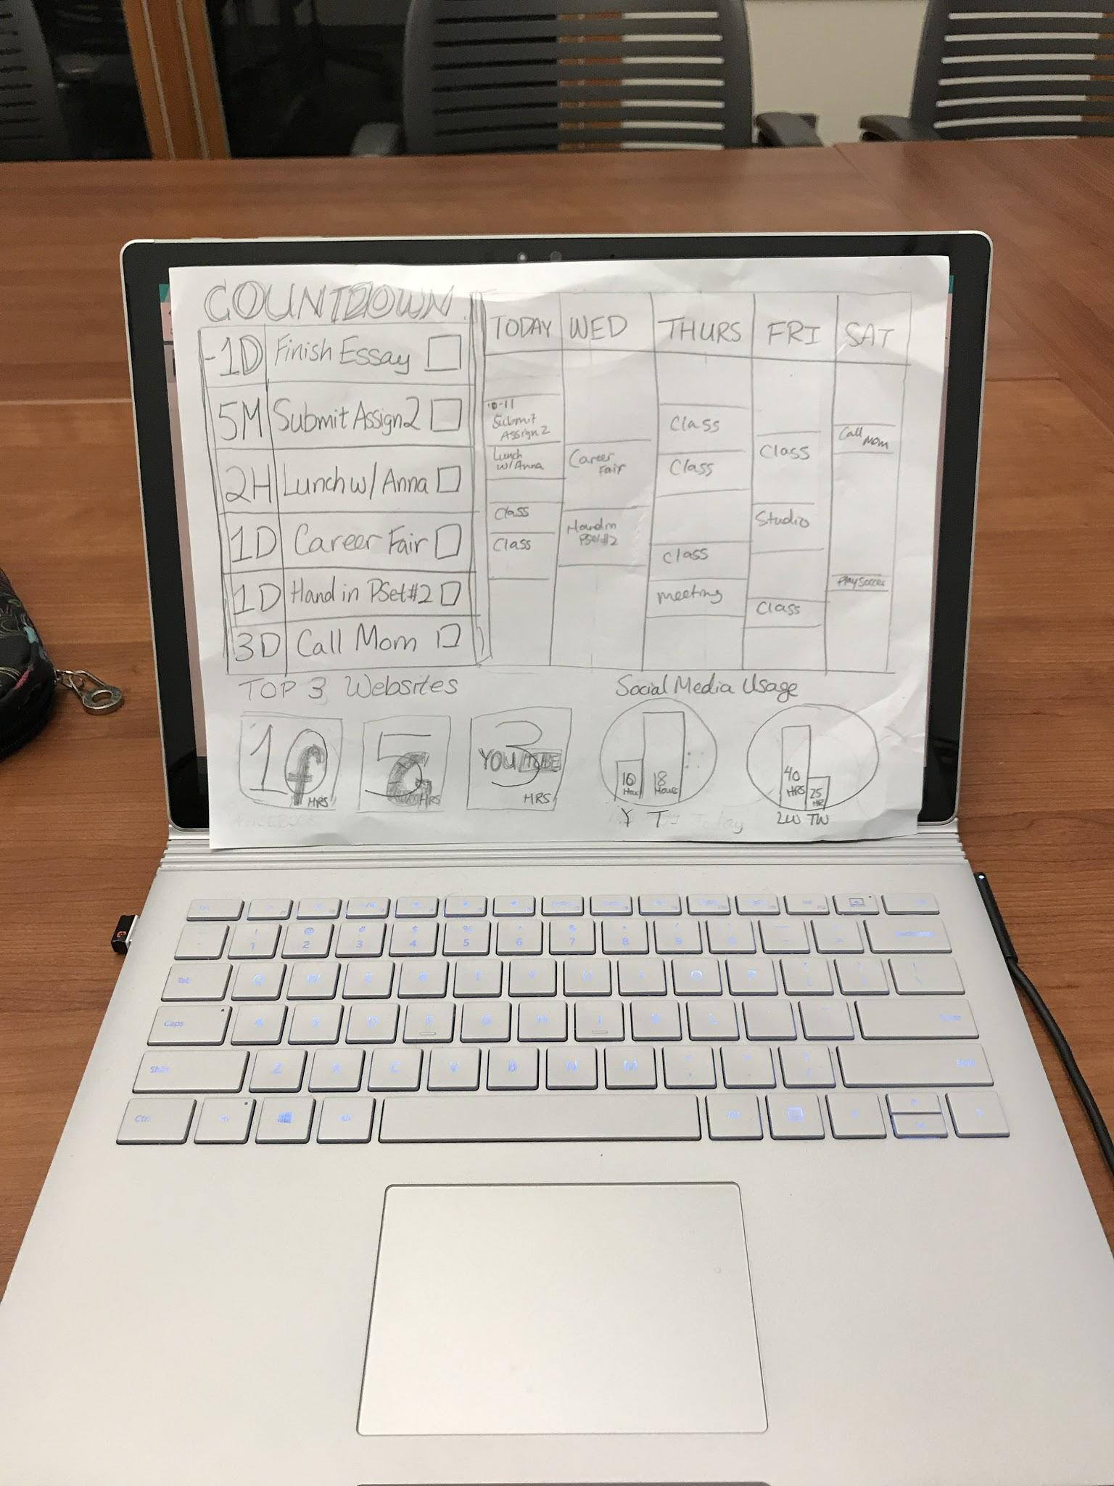
Prototype 1
Assumptions:
Visual reminders of tasks and time spent working on the homescreen/new tab screen increases productivity
Description:
We prominently displayed the user’s tasks, calendar, graph of social media usage, and top three visited websites as a mock screen saver
Notes:
-Assumptions: constant visual reminders increase productivity
-screen saver

Slide 21
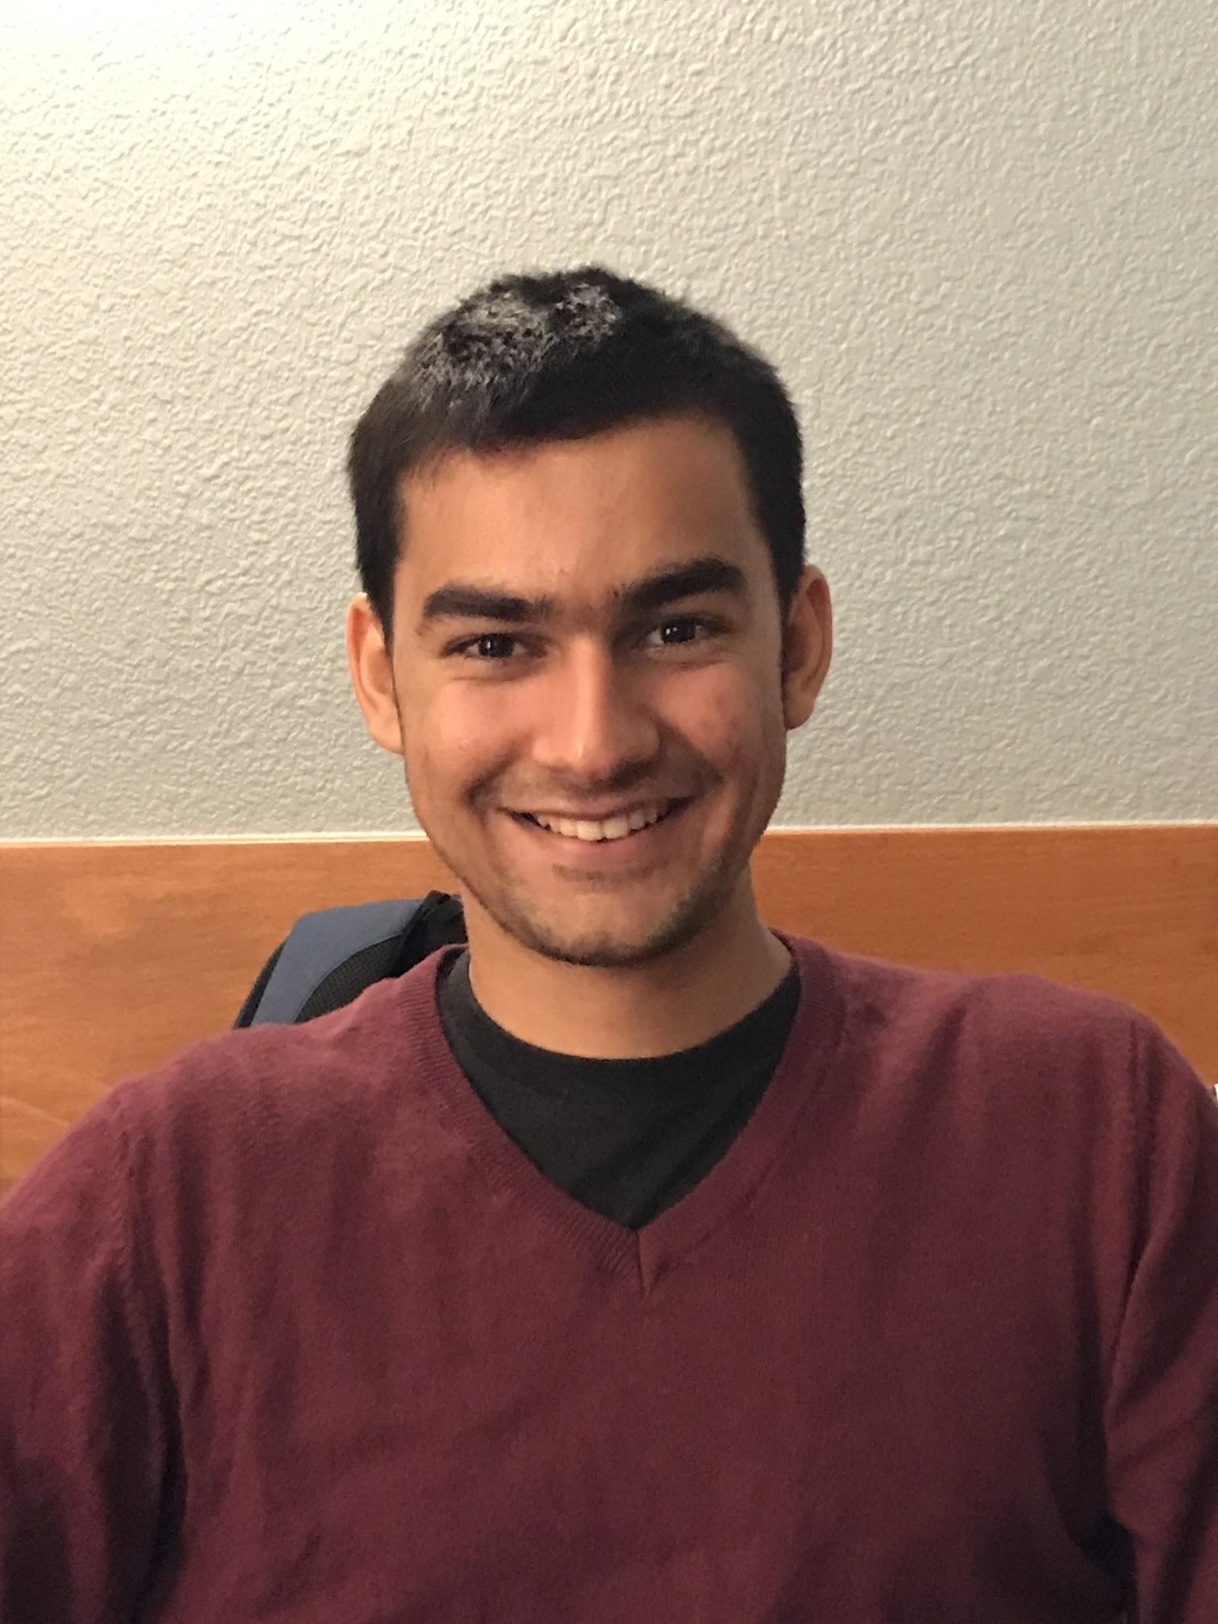
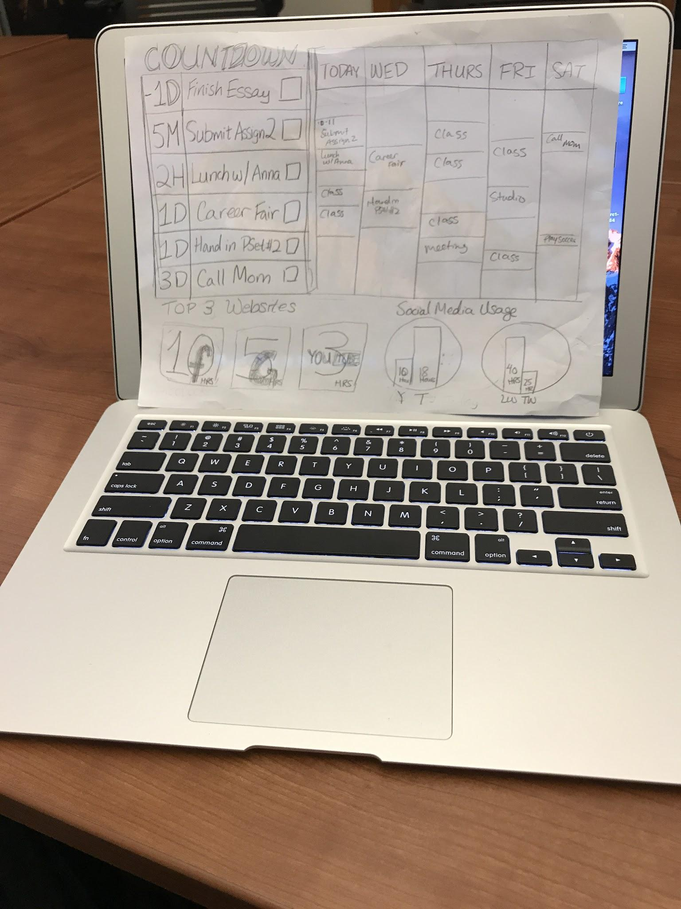
How it was tested:
We placed the drawn prototype on the user’s laptop screen
Asked them a series of questions regarding how they felt about displaying as their screensaver and their potential use.
Vivan
Notes:
Tested on Vivan
Place on his laptop

Slide 22
Things that worked
Things that didn’t work
The social media usage graphs
The overall urgency given off by the presentation of events and tasks
The user interface and arrangement
The top 3 websites visited widget

Slide 23
FINAL Assumptions &: Key Takeaways
The assumption was VALID
User commented on how he would use the prototype in his life to stay on track and be reminded of upcoming tasks he needs to do
However, he commented on how he would be tempted to cease usage for it later
User Suggested: That the user interface made him feel stifled and a change in arrangement might make a difference
New Assumptions: Users appreciate a cleaner interface that is less intimidating when dealing with their productivity habits

Slide 24
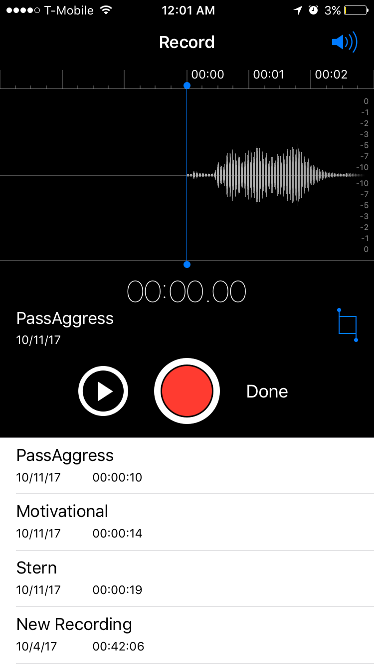
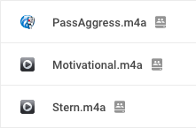
Prototype 2
Assumptions:
Vocal or auditory cues will increase productivity by effectively reducing social media distractions
Description:
Play auditory prompts whenever the user is distracted
Easily disabled by muting, not foolproof enough
Both stern and passive aggressive tones drew very negative reactions, including annoyance, anger, self-loathing, guilt, frustration, and offended leading to resistance and non-compliance
A little more positive on the motivational tone, Kaitlyn said “If I’m not in a bad mood and it was more motivational and nice, maybe I won’t be like shut up stupid computer voice.”
Suggestions: make it more difficult to avoid or uninstall, more positive, entertaining, and/or humorous, perhaps implement metrics that are not going to instill fear and informs the user of one’s performance relative to something (a goal, other people, etc.)
Notes:
Stern included, “Get off that website”, “You need to do your work”, “I know you can keep working”, and “stop slacking off”. The statements for passive aggressive included, “Is that a good idea?”, “You sure you want to do that?”, “Tasks don’t complete themselves”, and “What do you think you are doing?”

Slide 25
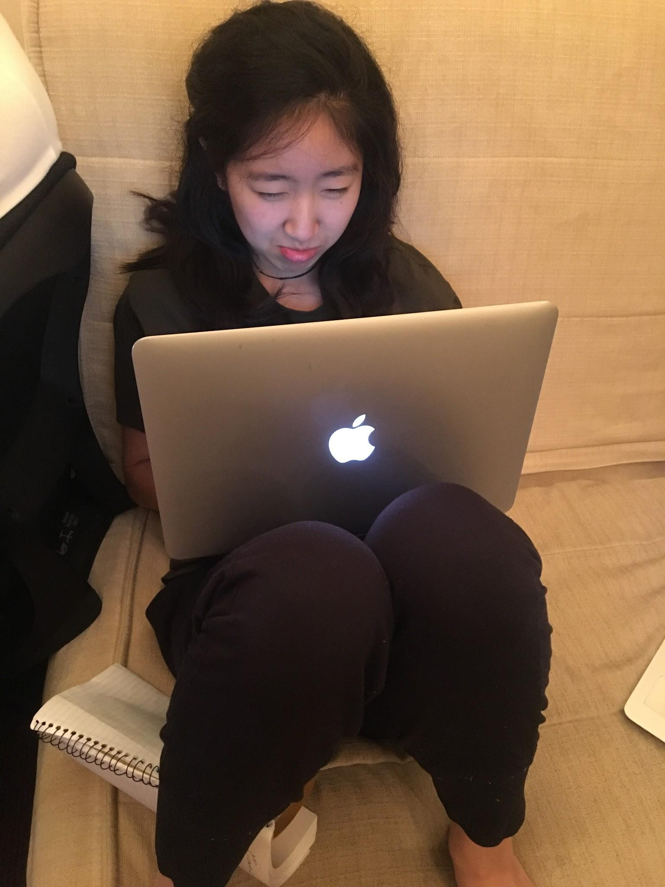
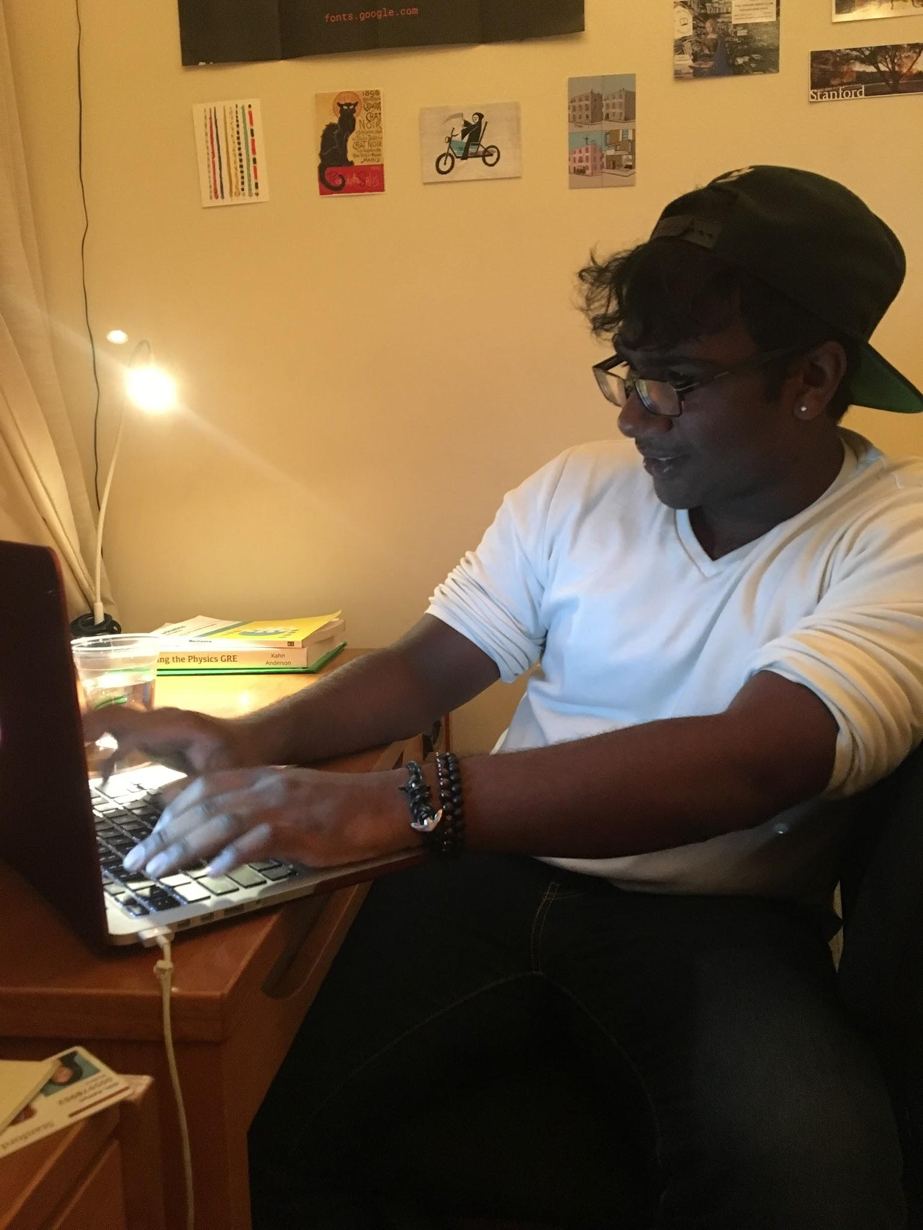
How it was tested:
We immediately played a pre-recorded auditory statement when working users switched to a non-work site
We then watched their reactions and feedback
Kaitlyn
Marcus

Slide 26
Things that worked
Things that didn’t work
They were bothered/ uncomfortable when visiting social media
Voice was too easily disabled by muting
Stern and passive aggressive tones drew very negative reactions

Slide 27
FINAL Assumptions &: Key Takeaways
The assumption was INVALID:
Auditory cues or prompts were too easily avoided/disabled.
Users disliked the concept overall
Users suggested: foolproof avoidance prevention, more positive or humorous method, a reward system through points and competition
New assumptions: people respond better to positive encouragement and reward compared to punishment or chiding

Slide 28
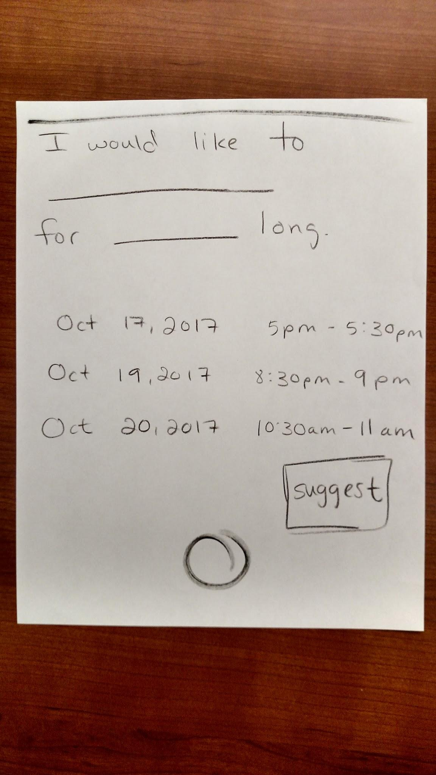
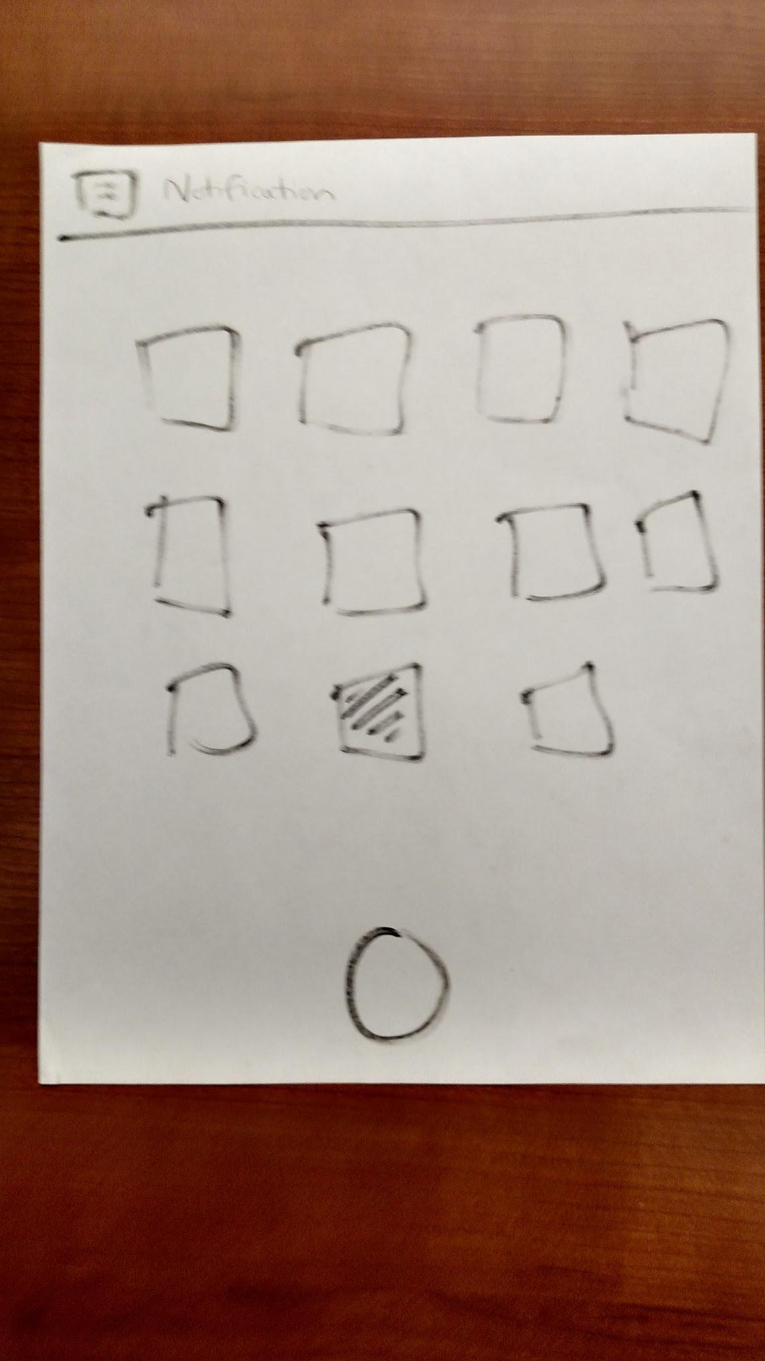
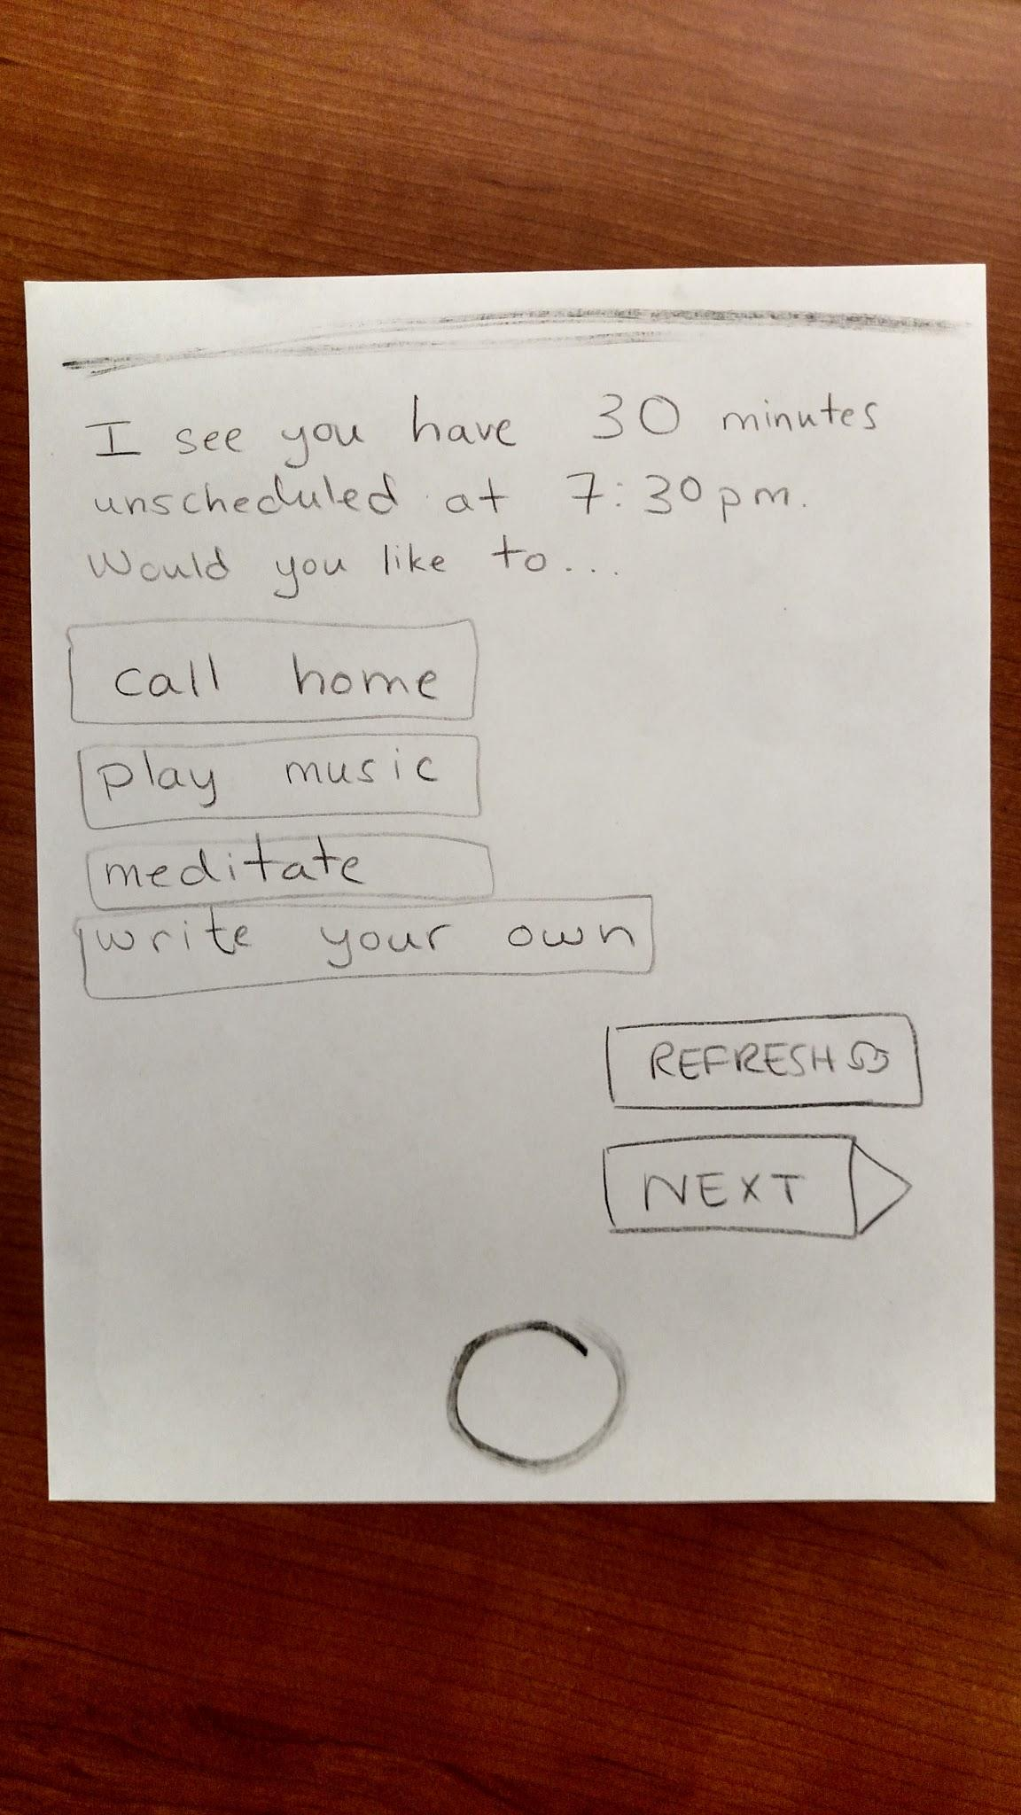
Prototype 3
Assumptions:
People will appreciate, and accept, self-care activity suggestions when reminded during their free time.
Description:
A mock mobile application. Each page handles a different interaction the user can have. Interfaces included: a home screen notification; an activity suggestion page; and an application home screen.

Slide 29
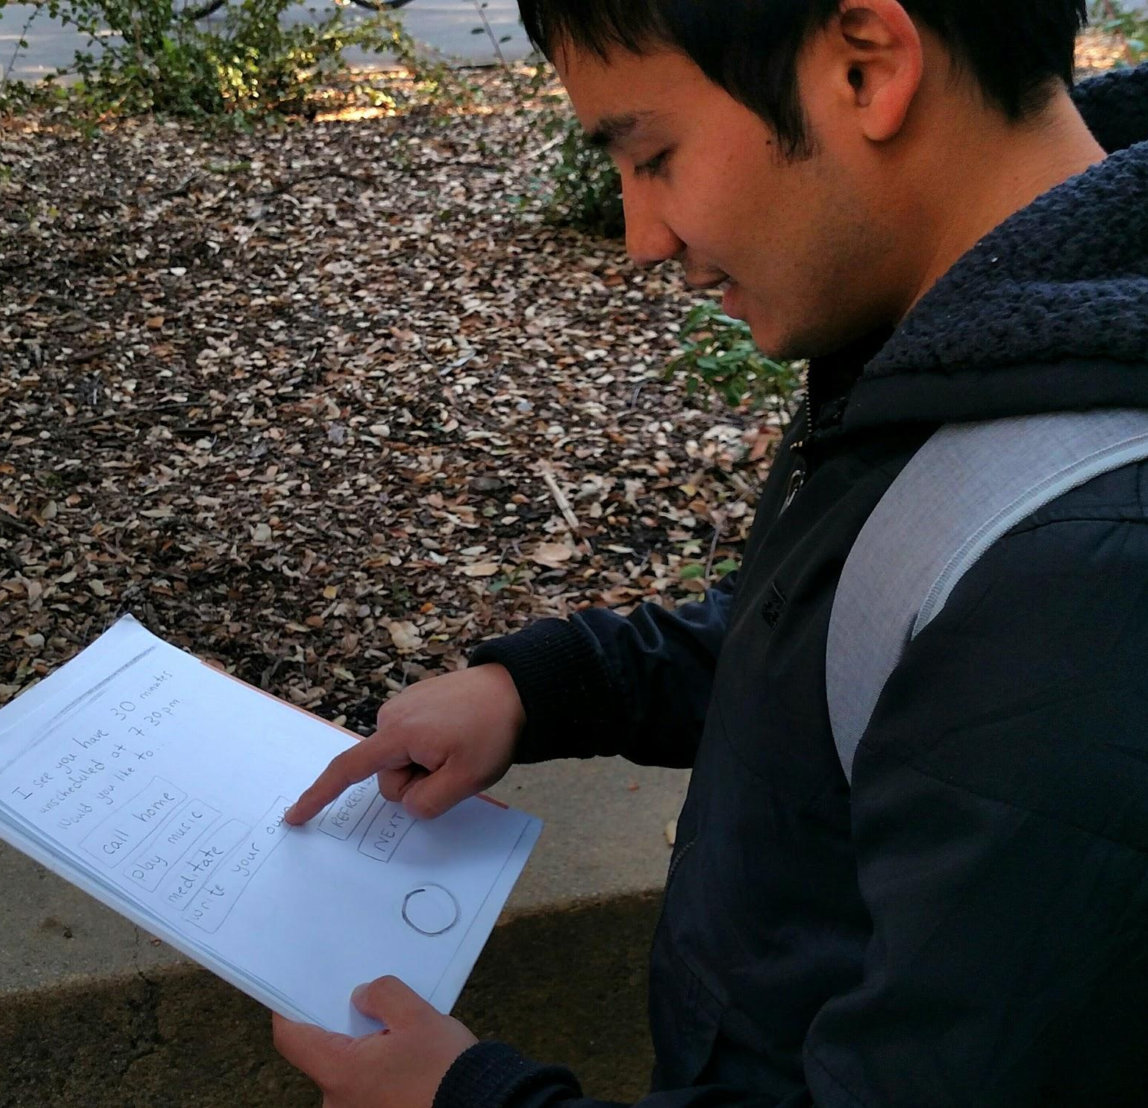
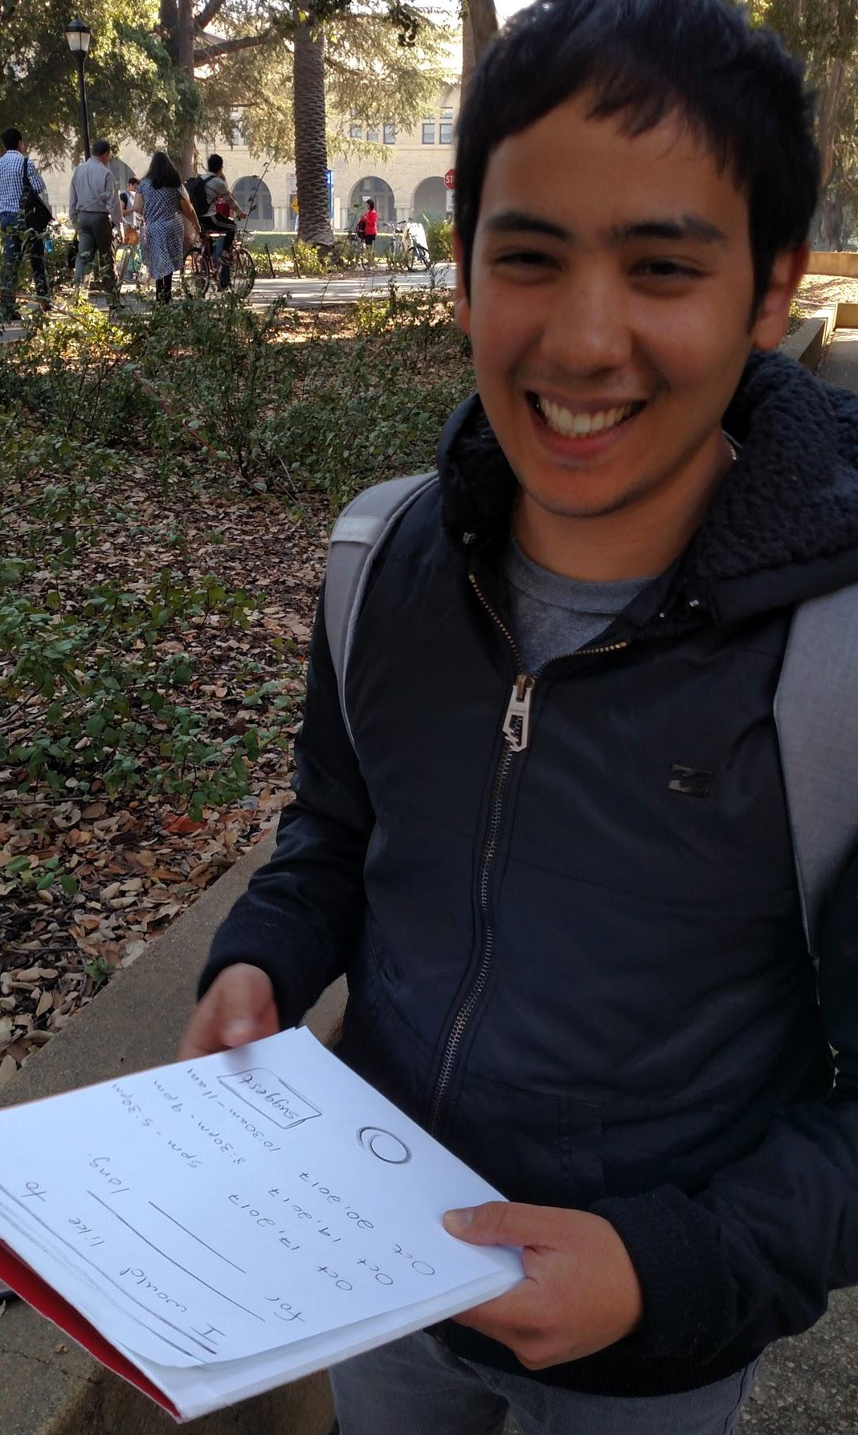
How it was tested:
We informed the user he received a notification in the status bar suggesting an activity
The user tried out the prototype, scheduling an activity.
We then noted his reactions and feedback.
Antuan
Notes:
We informed the user he received a notification in the status bar suggesting an activity. The user stepped through the functionality of the app through mock-button presses until his activity of choice was scheduled. We noted his reactions, including use case and points of frustration, as well as positive feedback.

Slide 30
Things that worked
Things that didn’t work
Reduced time and cognitive load required for scheduling well received
“Write your own” feature was useful to subject
The app home screen was confusing to user
Some of the suggestions were not relevant to user
Notes:
Users didn’t like being told what to do

Slide 31
FINAL Assumptions &: Key Takeaways
The assumption was VALID
User commented on how he would use the prototype in his life to schedule non-work activities such as hobbies and family time
He was confused about why he had to schedule the activity duration when there were already timeslot suggestions on the home screen.
User suggested: There be automatic refreshing of time slots.
New Assumptions: Users prefer an application with a shorter amount of time/clicks required to use it

Slide 32

Thank You!
Any Questions?

